Slide 2
CONTENTS
ABSTRACT
INTRODUCTION
LITERATURE SURVEY
EXHISTING SYSTEM
PROPOSED SYSTEM
SYSTEM ARCHITECTURE
MODULES
TECHNICAL SPECIFICATION
CONCLUSION

Slide 3
ABSTRACT
Promote the effective fisheries management and improving standards of fisheries management. Provide the technical and general knowledge necessary for competent fisheries management. Advance the standing of fisheries management as a profession.

Slide 4
INTRODUCTION
Aqua culture is one of the flourishing sectors in India as it contributes nearly 1.07% of the GDP. It is estimated that fish requirement of the country by 2025 would be order of 16 million tones but due to over fishing natural fisheries have been depleted as a result commercial aqua culture came into existence. But in recent years commercial aquaculture is facing many problems due to sudden climatic fluctuation which leads to changes in water quality parameters. At present aqua farmers are depending on manual testing for knowing the parameters of water. This will consume time and inaccurate because water quality parameters may alter with time. In order to overcome this problem, technology should be brought to aqua culture which increases the productivity and minimize the losses by constant monitoring of water quality parameters.

Slide 5
LITERATURE SURVEY
“Cyber Aqua Culture Monitoring System Using Arduino And Raspberry Pi,”
Internet of things is one of the rapidly growing fields for delivering social and economic benefits for emerging and developing economy. The field of IOT is expanding its wings in all the domains like medical, industrial, transportation, education, mining etc. Now-a-days with the advancement in integrated on chip computers like Arduino, Raspberry pi the technology is reaching the ground level with its application in agriculture and aquaculture. Water quality is a critical factor while culturing aquatic organisms. It mainly depends on several parameters like dissolved oxygen, ammonia, pH, temperature, salt, nitrates, carbonates etc.
Contd…

Slide 6
The quality of water is monitored continuously with the help of sensors to ensure growth and survival of aquatic life. The sensed data is transferred to the aqua farmer mobile through cloud. As a result preventive measures can be taken in time to minimize the losses and increase the productivity.
2. “Water Quality Monitoring and Control for Aquaculture Based on Wireless Sensor Networks,”
We have designed and presented a wireless sensor network monitoring and control system for aquaculture. The system can detect and control water quality parameters of temperature, dissolved oxygen content, pH value, and water level in real-time. The sensor nodes collect the water quality parameters and transmit them to the base station host computer through ZigBee wireless communication standard. The host computer is used for data analysis, processing and presentation using Lab VIEW software platform.

Slide 7
The water quality parameters will be sent to owners through short messages from the base station via the Global System for Mobile (GSM) module for notification. The experimental evaluation of the network performance metrics of quality of communication link, battery performance and data aggregation was presented. The experimental results show that the system has great prospect and can be used to operate in real world environment for optimum control of aquaculture environment.

Slide 8
EXISTING SYSTEM
In Existing system, fisheries checks their ponds daily. And manually we will measure the pH value of water. pH is measured by the pH meter made of electronic device. Electronic meter is connected to pH probe (a glass electrode). It displays the readings.
The key part of pH meter is the probe. It is like a pole structure generally manfactured by the glass that contain a bulb at the bottom and also contain sensitive sensor. Suppose we want to find out solution, probe is dipped into the solution to easily get the readings.
Suppose the fisheries want to find out the characteristics of water then they must collect water from the ponds and take to laboratory. Check the parameters of water samples. If those samples are not good results then they must take necessary actions. So this procedure takes a lot of time and manual testing is not possible in unhygienic environmental conditions.

Slide 9
PROPOSED SYSTEM
The PROPOSED METHOD:
proposed model mainly focuses on constant monitoring of water quality parameters from time to time in order to take preventive measures before actual damage was done. The proposed architecture consists of four modules
power module
sensor module
microcontroller module
output module

Slide 10
Power module:
The power module we opted is more eco-friendly. The power module comprises of solar panel, charge controller, battery,
Sensor module:
The sensor module comprises of several sensors such as pH, Salt,rust particles and an water level .These sensors are mounted on Arduino and are used for sensing the water quality parameters from time to time.

Slide 11
Micro controller module: It is considered as heart of this architecture. Arduino UNO is used as computer in this paper .Arduino UNO. It has several advantages when compared to other micro-controllers such as inbuilt Wi-Fi module. The Program for collecting the sensor data is written in C++ language and sends that data to the cloud database. The server side program continuously monitors the sensor values whether they are within the threshold range .If the values deviates from the threshold range a feasible solution was send to the output module.

Slide 12
Output module:
Aqua farmer mobile is taken as an output module. An app has been loaded in the mobile which consists of two buttons 1) Get data 2) History. When we press getdata button current water quality parameters values has been displayed on the farmers mobile. Message alerts will be sending to the farmer if there is deviation from the threshold range with necessary action to be taken.

Slide 13
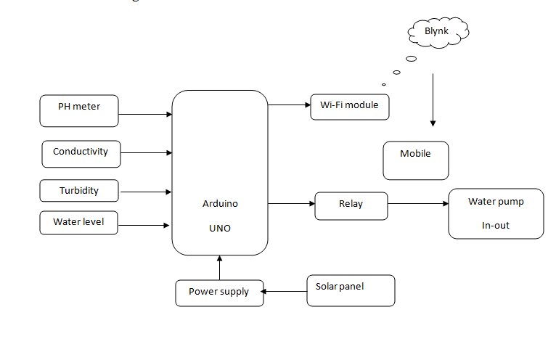
SYSTEM ARCHITECTURE

Slide 14
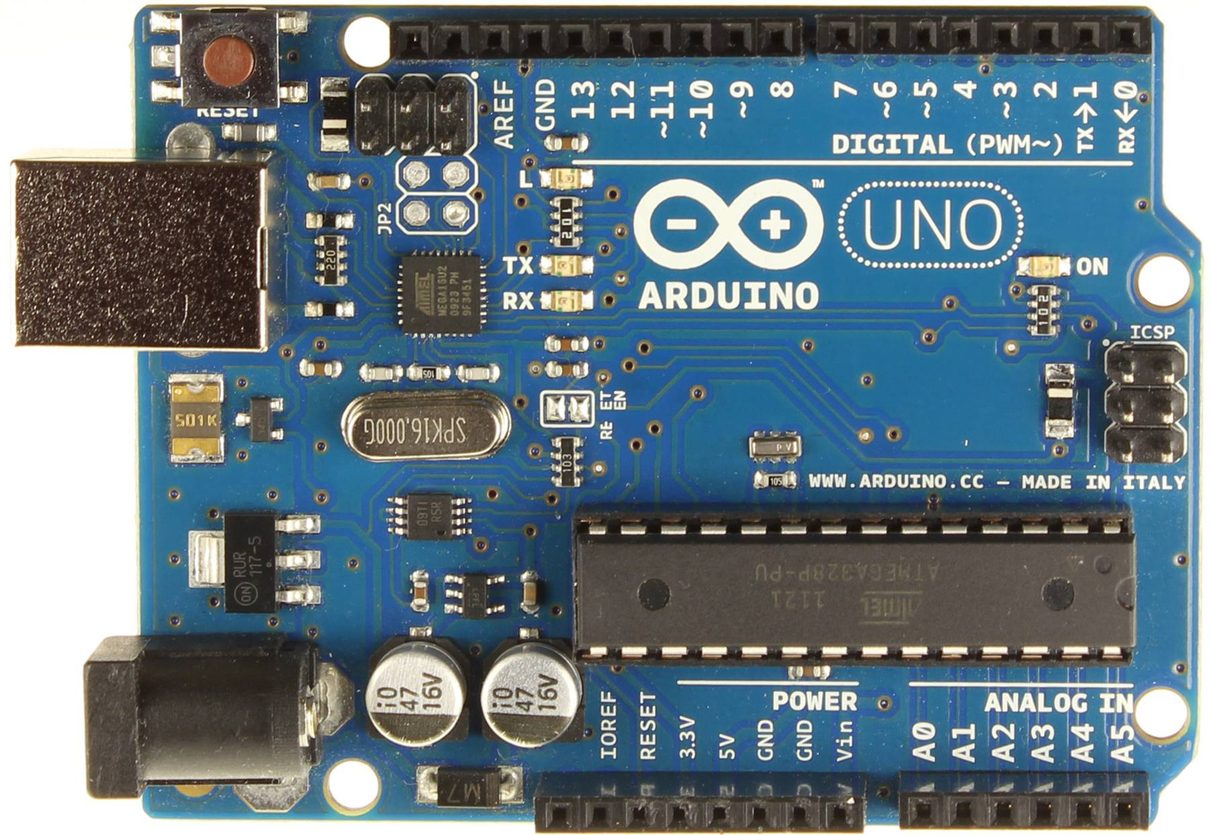
MODULES
Arduino:

Slide 15
Technical Specification
Microcontroller | ATmega328P
Operating Voltage | 5V
Input Voltage (recommended) | 7-12V
Input Voltage (limit) | 6-20V
Digital I/O Pins | 14 (of which 6 provide PWM output)
PWM Digital I/O Pins | 6
Analog Input Pins | 6
DC Current per I/O Pin | 20 mA
DC Current for 3.3V Pin | 50 mA
Flash Memory | 32 KB (ATmega328P) of which 0.5 KB used by bootloader
SRAM | 2 KB (ATmega328P)
EEPROM | 1 KB (ATmega328P)
Clock Speed | 16 MHz
LED_BUILTIN | 13
Length | 68.6 mm
Width | 53.4 mm
Weight | 25 g

Slide 16
Advantages OF PROPOSED SYSTEM
Mobility
Ease of Installation
Flexibility
Cost
Reliability
Security
Use unlicensed part of the radio spectrum
Roaming
Speed

Slide 17
Disadvantages of existing system:
1. All pH meters need to be calibrated at some frequency
2. The probe has to be cleaned well after every use to make sure you get a reliable reading next time
3. It takes lot of time to test pH in manually
4. Manually testing is not possible in unhygienic environmental conditions.

Slide 18
CONCLUSION
Developing the capacity of farmers so that, through their own observations and reasoning, they are able to solve limitations to the implementation of rural aquaculture projects, thereby improving the productivity of household farm units
Protecting water sources.
Generating a reliable data base on production and the costs of different production systems.
Achieving the capacity of farmers to market their agricultural products, including those of aquaculture origin, which contribute to income generation.

